Slide 1
Developing Affordable Housing in New York City
Jerrod Delaine

Slide 2
Theory
First lets discuss the “Why”

Slide 3
Theory
Why do residents in cities want affordable housing?
Quality of Life
Financial Security
Safety and Security

Slide 4
Theory
Why do governments encourage affordable housing?
Economic viability of the city for current and potential residents
Maintaining communities and residents

Slide 5
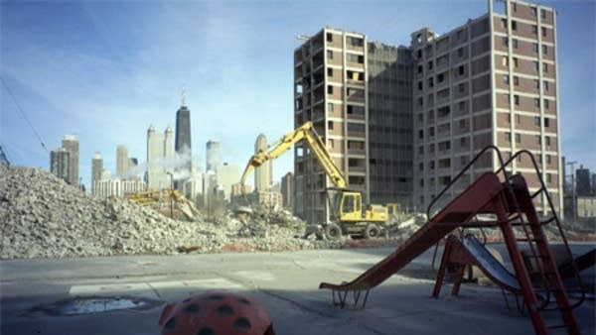
Theory
Why do governments discourage affordable housing?
Cities in financial strain struggle to maintain affordable housing
Reduced federal investment

Slide 6
Practice
Now let’s discuss the ”How”

Slide 7
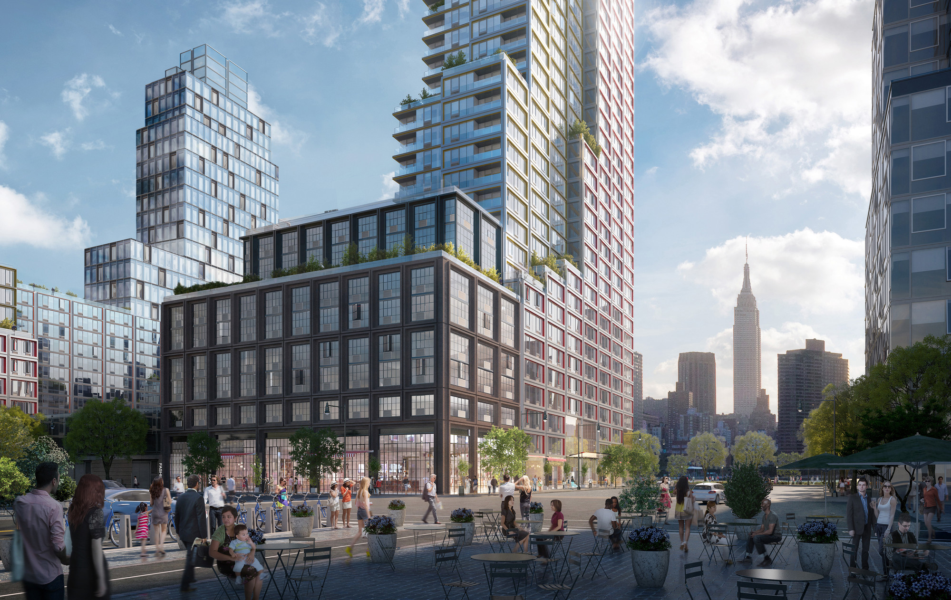
Practice
Acquisition Rehab / Preservation
Existing Buildings
Existing Tenants in Place
Upgrade building without displacement
New Construction

Slide 8
Practice
Finance
Equity
Low Income Housing Tax Credits
Grants / Subsidies
Debt
Tax Exempt Bonds
First Mortgage
Second Mortgage

Slide 9
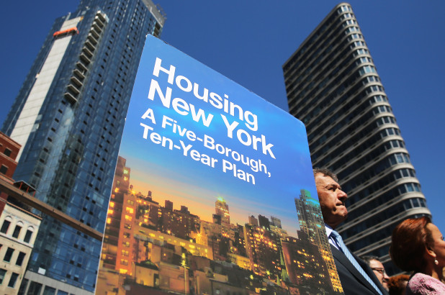
Practice
Finance
Government Entities
City
NYC Housing and Preservation Department – HPD
NYC Housing Development Corporation - HDC
NYC Economic Development Corp – EDC
State
NYS Housing Finance Agency – HFA
Federal
Department of Housing and Urban Development - HUD

Slide 10
Practice
Finance
Developer Income Stream
Developer’s Fee
Construction Closing
During Construction
Construction Completion
Stabilization
Net Cash Flow

Slide 11
Practice
Construction
Quality
Government Design Standards
Green
LEED
Enterprise Green Communities
Energy Star
Costs
Prevailing Wage/Union vs Standard Construction

Slide 12
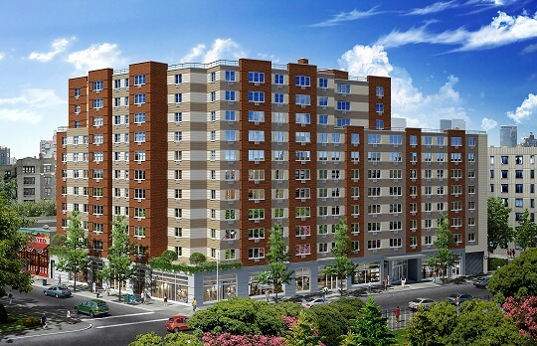
Practice
Law
Rent Control
Rent Stabilization
Federal Funding Compliance
Resident Income Documentation
Federal Subsidy Payment / Vouchers

Slide 13
Practice
Property Management / Asset Management
Tenant Relations importance
Local political influence
Landlord/Tenant Court Case Management
Heating and Cooling Systems Management
Expense management with fixed income streams

Slide 14
Practice
Current Opportunities
Technology
New Financing Programs
Strategic Joint Ventures
Current Issues
Economic Viability of the Business Model
Frozen Rents with variable expenses
Increasing Hard Costs
Limited cheap land

Slide 15
Questions?

